Slide 1
Data Analytics using KNIME open source tool
Team: Olga Bode, Eric Dörheit, Dorothea Poljak
Supervisor: Dr. Marcela Charfuelan

Slide 2
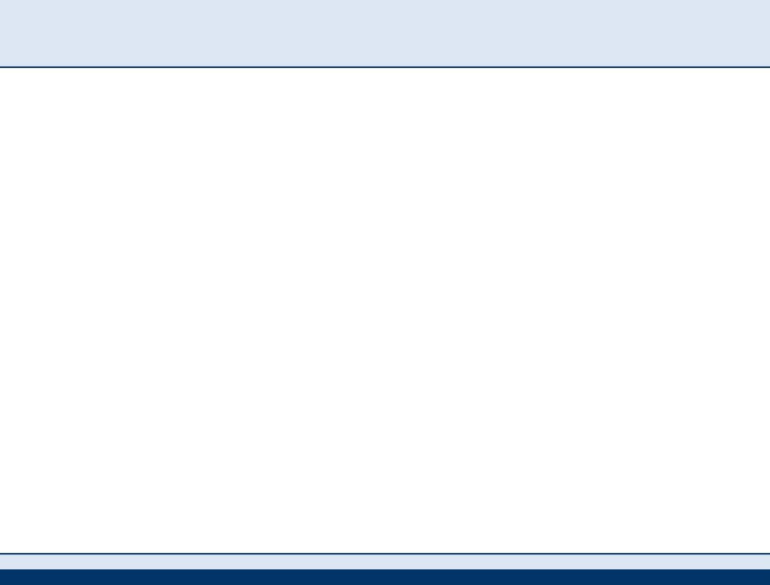

Anomaly Detection Techniques
Classification
Clustering
Statistical

Slide 3
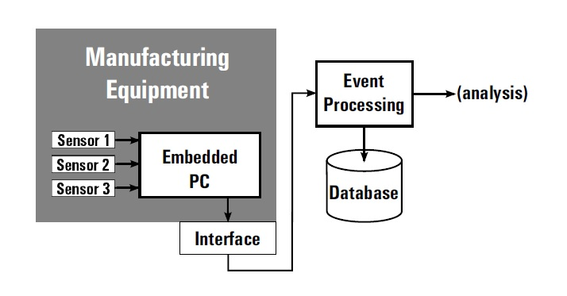
Sensor Network

Slide 4
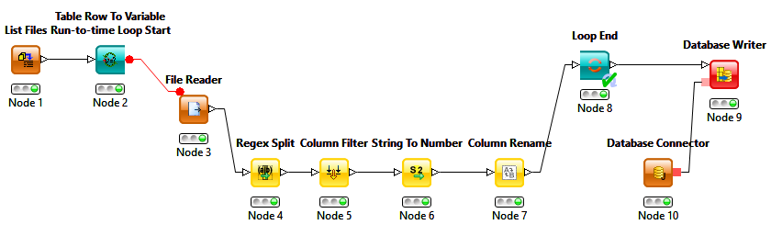
ETL in KNIME
Storing data in MySQL database (ETL):
1. Community Nodes extraction
2. Data Manipulation Nodes transformation
3. Database Nodes loading
Extraction
Transformation
Loading

Slide 5
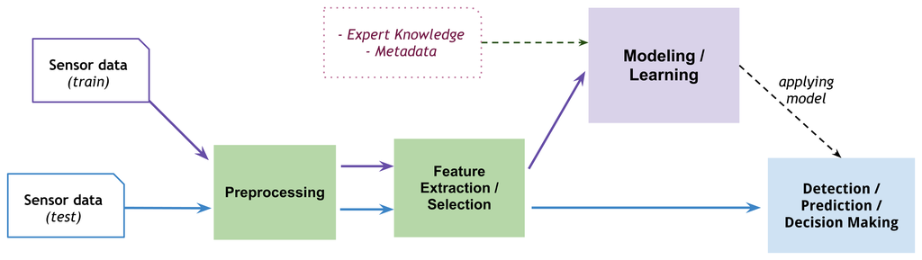
Classification: Modeling process

Slide 6
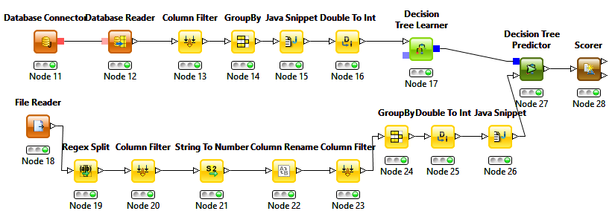
Classification: Modelling process in KNIME
Training data
Learning Models
Prediction
Feature extraction
Scoring
Testing data
Feature extraction

Slide 7
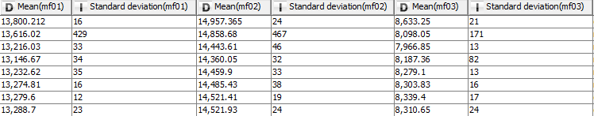
Classification: Feature Extraction
mf01, mf02, mf03 Mean() Standart deviation() or relative variation() | Record the energy consumption of the manufacturing equipment What is average energy consumption per each sensor per second? What is relative variation per each energy consumption sensor per second? (used to trigger the recording of the raw values of the sensor)

Slide 8
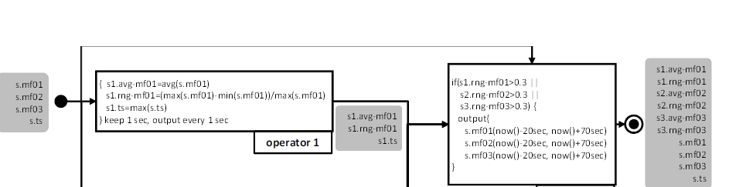
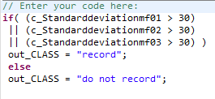
Classification: Classes
Condition: If the relative variation on any of the energy measuring sensors > 30% => the raw data from each of the sensors needs to be recorded.
2 classes:

Slide 9
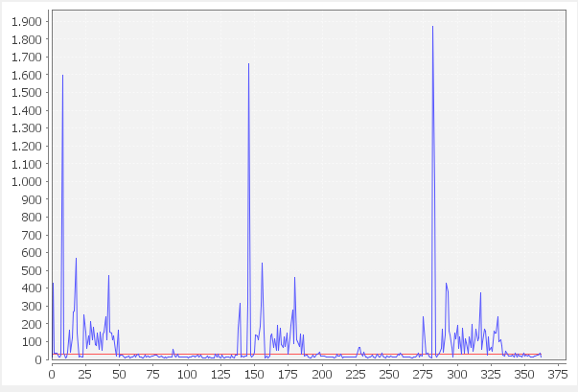
Classification: Occurrence of validation
anomaly
anomaly

Slide 10
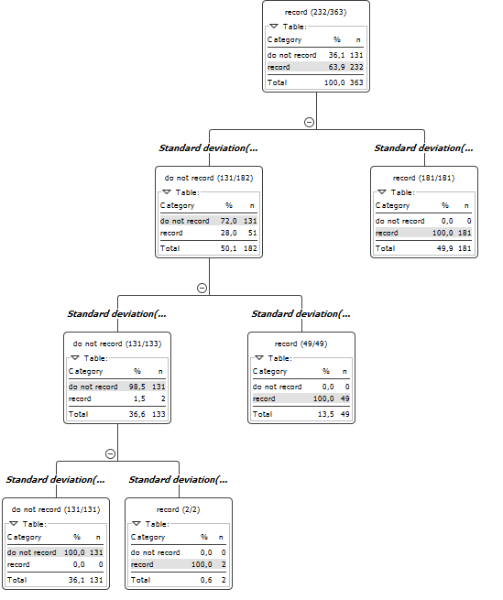
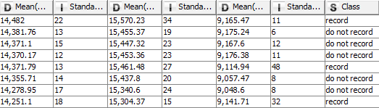
Classification: Decision Tree
predictors
target
The final result is a tree with decision nodes and leaf nodes.
Leaf node represents a classification or decision
Goal: predicting the target variable value (class) based on several input variables (predictors)

Slide 11
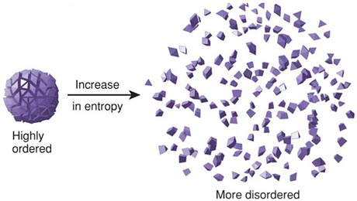
Decision Tree: Entropy
Entropy is a measure of the disorder of a system.
low entropy
more order

Slide 12
Classification: Decision Tree Algorithm
One of the most successful techniques!
Uses Entropy and Information Gain to construct a decision tree
The information gain is based on the decrease in entropy after a data set is split on an attribute. Constructing a decision tree is all about finding attribute that returns the highest information gain.
Step 1: Calculate entropy of the target.
Step 2: The data set is then split on the different attributes.
Step 3: Choose attribute with the largest information gain as the decision node:
Gain = Entropy(before) – Entropy(after)
Step 4a: A branch with entropy of 0 is a leaf node.
Step 4b: A branch with entropy more than 0 needs further splitting.
Step 5: The Decision Tree algorithm is run recursively on the non-leaf branches, until all data is classified.

Slide 13
Classification: Decision Tree

Slide 14
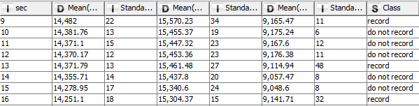
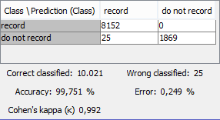
Classification: Applying Learning Model
applying model
confusion matrix
Gut choice of the model!

Slide 15
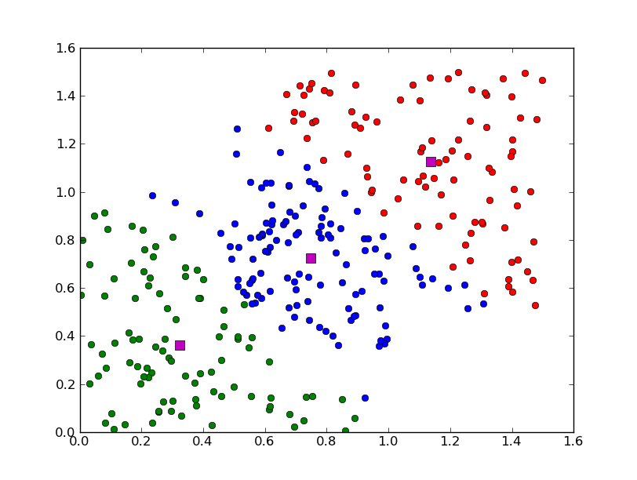
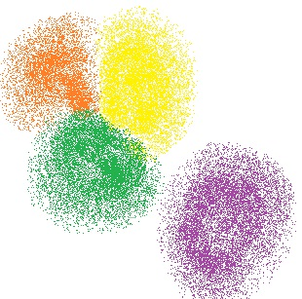
Clustering: Overview
Unsupervised machine learning technique
Assignment of data instances to clusters
Cluster contains similar data instances
Clustering ≠ Classification (clusters are discovered, classes are given)
Different algorithms:
  Assign all data instances to clusters
  Let data instances be unassigned (as “noise”)

Slide 16
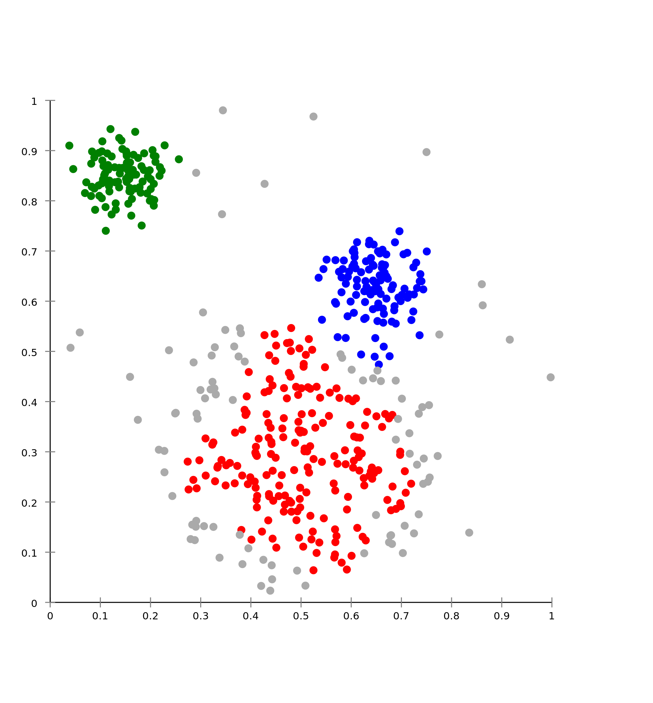
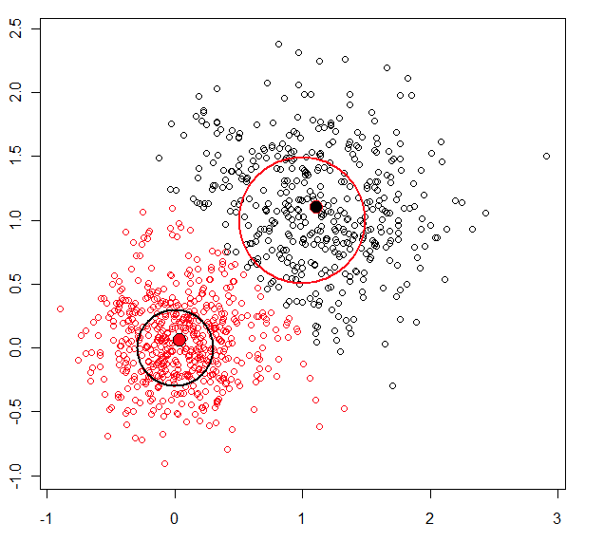
Clustering: Anomaly Detection
What is an anomaly regarding clustering?
  Normal data instances belong to clusters while anomalies don’t
  Normal data instances can be found closest to a cluster centroid while anomalies are far away from their closest cluster centroid
  Normal data instances lie in dense clusters while anomalies are in small or sparse clusters

Slide 17
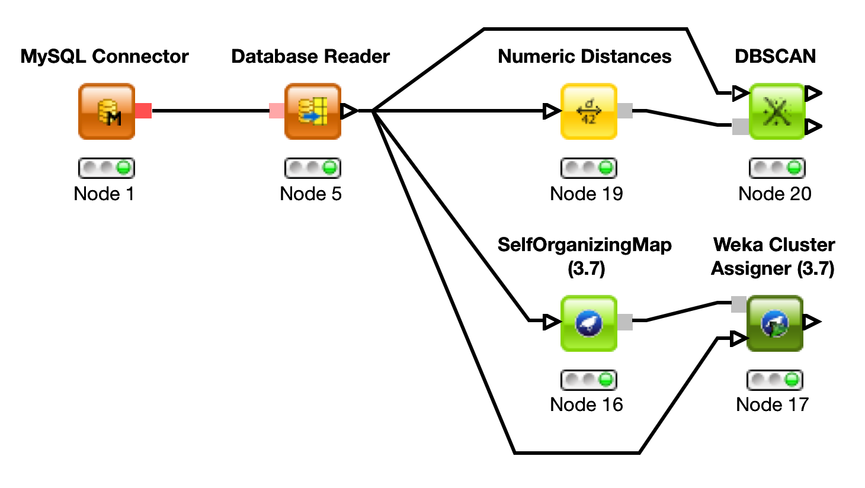
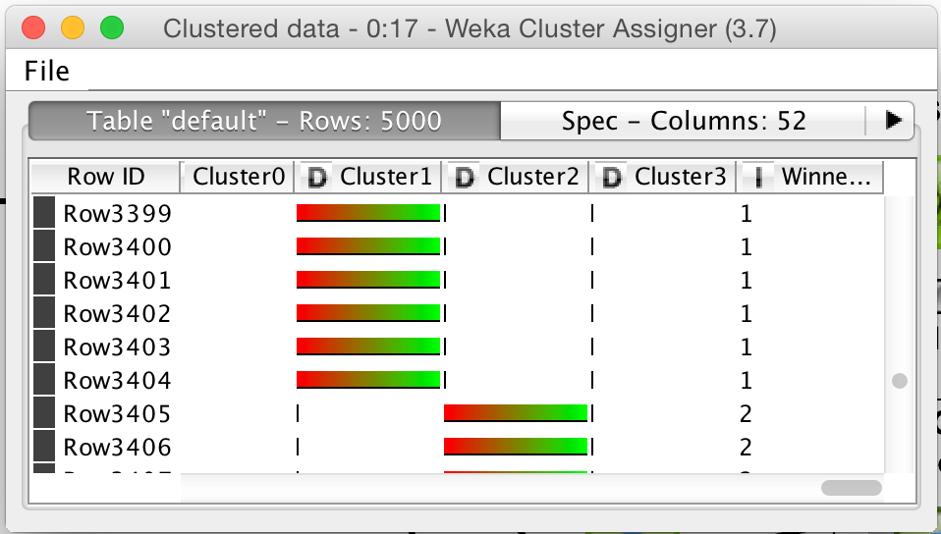
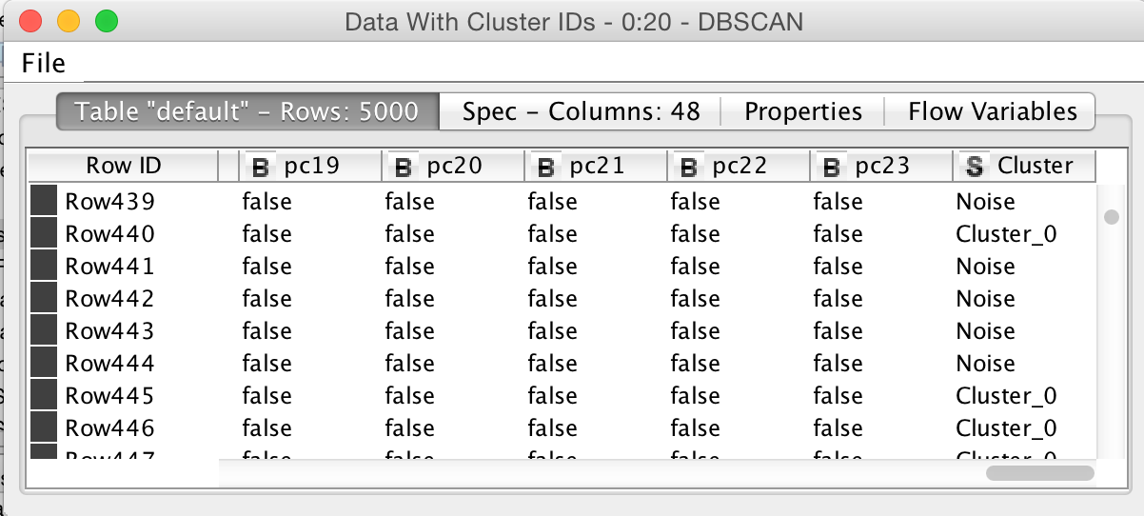
Clustering with KNIME
Read data from database
Compute clustering model
Assign data instances to clusters

